Slide 1
3rd Gaia-X hackathon
Bootstrapping
Gaia-X Ecosystems
Kai Meinke Business Lead, Member of the Board kai@delta-dao.com

Slide 2




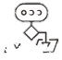

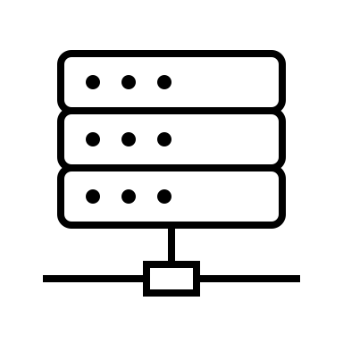

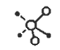






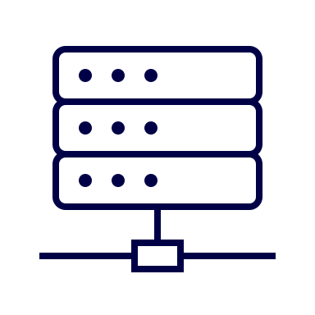


bootstrapping Gaia-X ecosystems
there will be many ecosystems. how to start a decentralized one?
Ocean ecosystem
ecosystem 2
ecosystem 3
ecosystem …
ecosystem n
technical interop.
usage plane
extended governance
management plane
common digital Gaia-X governance
Gaia-X Trust Framework
Gaia-X Registry service
Gaia-X Compliance service
trust plane
federation services toolbox
service catalogue
service provider
consumer
catalogue cache
data
compute cluster
algorithm
DLT
verifiable credential wallet
federator
validator
Image is licensed under a CC BY 4.0 license, Gaia-X European Association for Data and Cloud AISBL.
Remixed by deltaDAO AG for illustration purposes.

Slide 3




bootstrapping Gaia-X ecosystems
a Web 3.0 ecosystem
service provider + federator
consumers
consumers
portal for
portal
catalogue cache
space B
consumer
service offering
federator
service provider
validator
compute cluster
federation services toolbox
data providers
portal for
space A+B
federator+CSP
B
prosumers
portal for
A
space B+C
portal for
C
space A+B+C
licensed under CC-BY-4.0, deltaDAO AG

Slide 4
bootstrapping Gaia-X ecosystems
vision Gaia-X & European data economy / data act
fairness & competitiveness
GDPR-compliance & data security
increase access, lower barriers & transaction costs
minimize lock-in & open-source software
incentives to share & incentives to collaborate
enable investments, foster innovation, & fair returns
auditability, provenance & transparency
open private data & increase B2B use
reduce fragmentation & EU-wide regulatory framework
licensed under CC-BY-4.0, deltaDAO AG

Slide 5

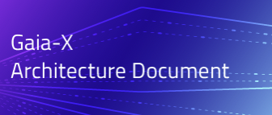
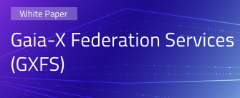
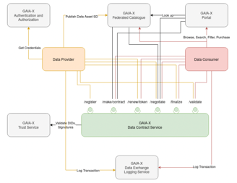
bootstrapping Gaia-X ecosystems
our starting point
expectation vs. reality
© Federal Ministry for Economic Affairs and Climate Action
exceptional & necessary
licensed under CC-BY-4.0, deltaDAO AG

Slide 6
bootstrapping Gaia-X ecosystems
Gaia-X federation services & the Minimal Viable Gaia-X
KYB
metadata contracts & caches
marketplace GUI & API
Gaia-X Authentication and Authorization
Gaia-X Federated Catalogue
Gaia-X portal
Service Provider
Service Consumer
SSI / VC
/register
/make/contract
/renew/token
/negotiate
/finalize
/validate
Gaia-X Trust Service
Gaia-X
Data Contract Service
graph and DLT
contracts & access controller
Source: Sovereign Data Exchange Data Contract Service https://www.gxfs.de/federation-services/overview-specification-documents/
GAIA-X Data Exchange Logging Service
licensed under CC-BY-4.0, deltaDAO AG

Slide 7
bootstrapping Gaia-X ecosystems
guiding principles
reuse existing software as much as possible
be transparent, use free open-source
enable technical data sovereignty
enable Gaia-X Trust Framework
sustainable business models for all participants
no lock-in, no central point of failure or control
licensed under CC-BY-4.0, deltaDAO AG

Slide 8
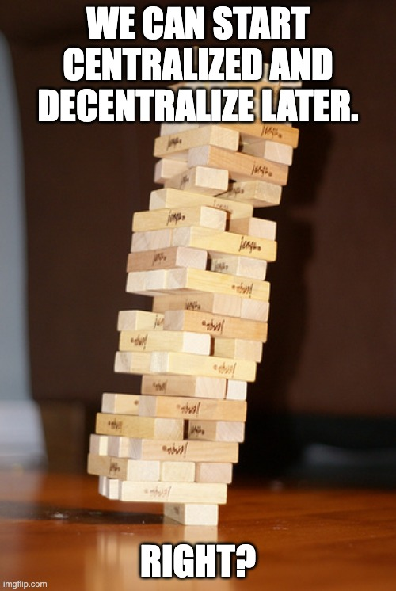
bootstrapping Gaia-X ecosystems
bootstrapping Gaia-X ecosystems
why decentralized?
it is very hard to decentralize later.
licensed under CC-BY-4.0, deltaDAO AG

Slide 9
bootstrapping Gaia-X ecosystems
why early decentralization is key
main challenges: Coordination problems & lack of trust
could we not build one platform then and be done with it?
unique: Data is non-rival in use and non-exhaustible. Its value grows with usage.
this has substantial consequences for competition policy and value distribution!
virtual markets have low friction. This leads to strong concentration processes.
economies of scale are a strong driver of concentration.
licensed under CC-BY-4.0, deltaDAO AG

Slide 10
bootstrapping Gaia-X ecosystems
economics of data ecosystems
capacity constraints leading to competition do not apply as in the physical world.
subsidies allow first movers to capture a large market share.
high switching costs generate a lock-in effect and can be exploited by platform owners.
hence, direct and indirect network effects plus economies of scale often give rise to ‘winner-takes-all markets’ or ‘tippy markets’ - which are hard to impossible to reverse.
emerging gatekeepers will "regulate" competition to their favor. This is a B2B environment.
incentive design & competition are critical success factors for sustainability & security.
licensed under CC-BY-4.0, deltaDAO AG

Slide 11
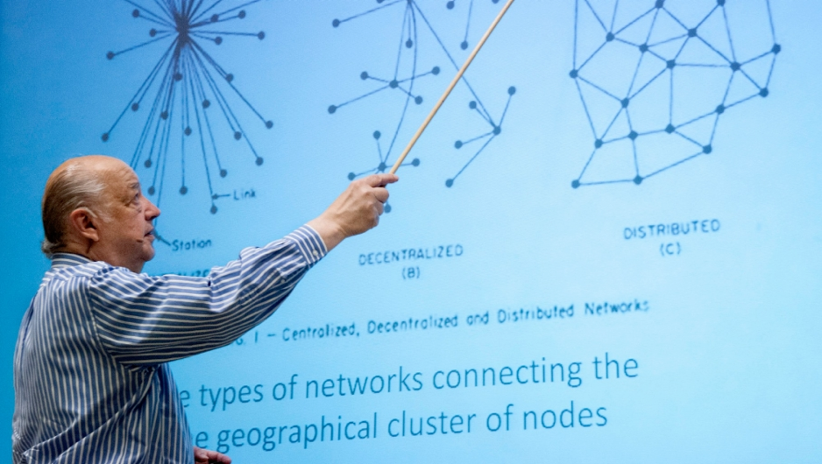
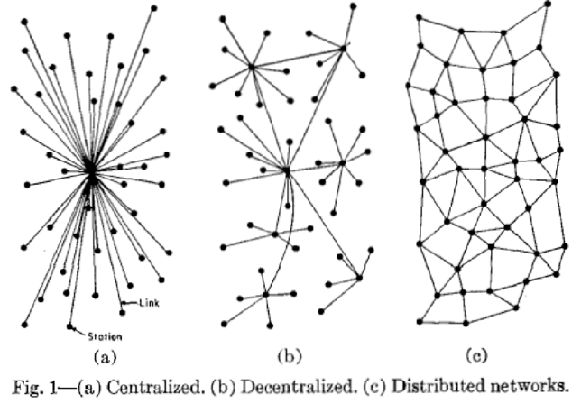
bootstrapping Gaia-X ecosystems
bootstrapping Gaia-X ecosystems
distribution leads to resilience and reduces dependencies
Paul Baran’s seminal 1964 article “On Distributed Communications Networks”
centralization can be an expensive liability.
Paul Baran presents his work at a RAND Alumni Association event on July 25, 2009
Photo by Diane Baldwin/RAND Corporation
licensed under CC-BY-4.0, deltaDAO AG

Slide 12
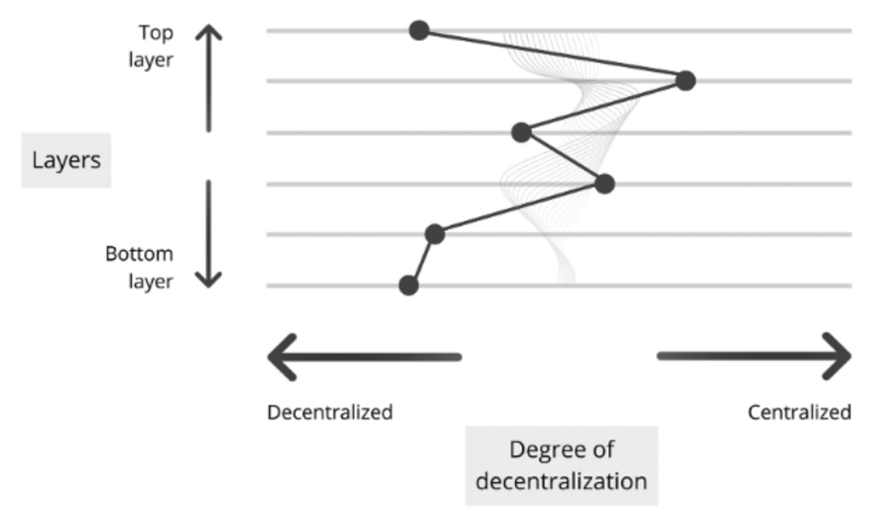
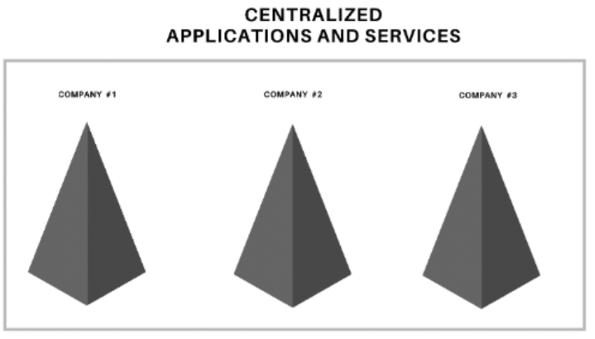
bootstrapping Gaia-X ecosystems
bootstrapping Gaia-X ecosystems
decentralization - a spectrum across layers
© Thibault Schrepel, Blockchain + Antitrust, https://doi.org/10.4337/9781800885530
companies work differently...
licensed under CC-BY-4.0, deltaDAO AG

Slide 13
bootstrapping Gaia-X ecosystems
bootstrapping Gaia-X ecosystems
benefits of using Web3.0 technology
Web 1.0 (1980 - 2005) | Web 2.0 (2005 - 2020) | Web 3.0 (2020+)
open protocols | siloed services | open protocols
decentralized | centralized | decentralized, distributed
dedicated infrastructure | cloud computing | distributed computing
community-governed | governed by few entities | community-governed
content owned by users | content owned few entities | content owned by users
read only | read-write | read-write-own
page views | cost-per-click | token economics
static content | dynamic content | interoperable content
licensed under CC-BY-4.0, deltaDAO AG

Slide 14
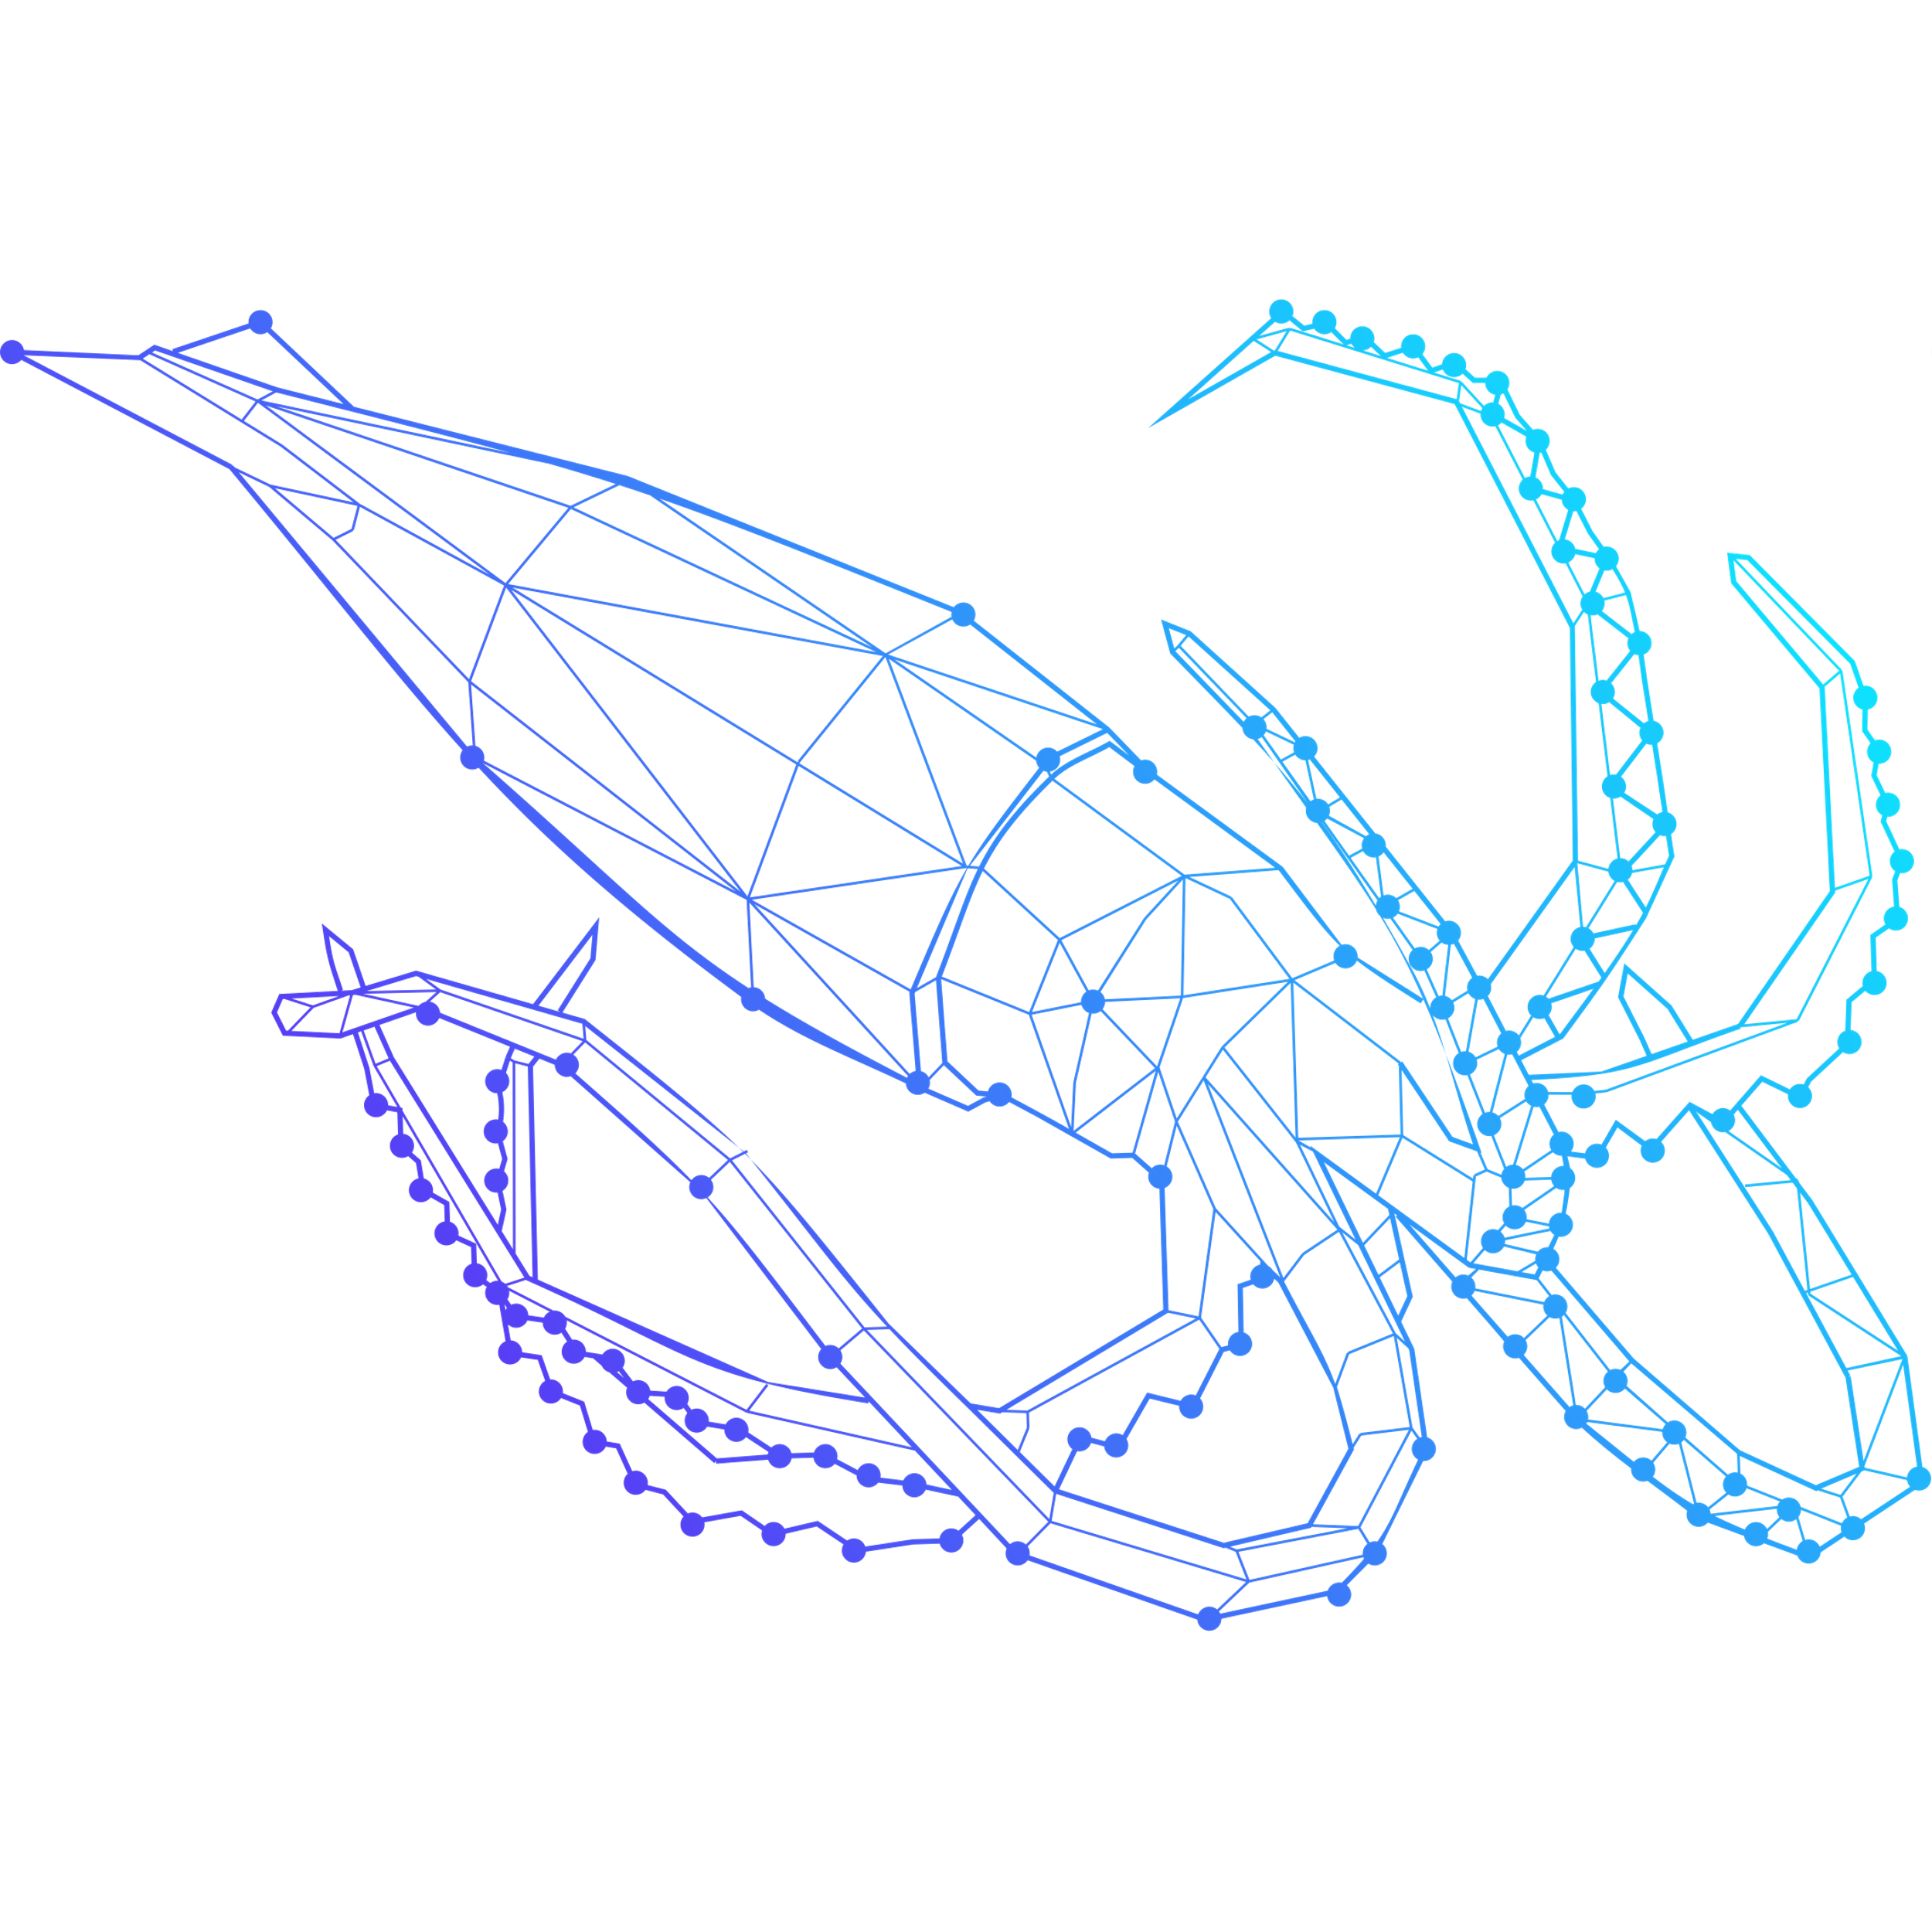
portal.minimal-gaia-x.eu

Slide 15



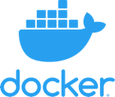






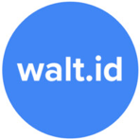




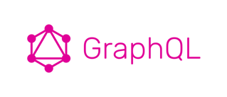







bootstrapping Gaia-X ecosystems
made with love and 100% free open-source technology
licensed under CC-BY-4.0, deltaDAO AG

Slide 16







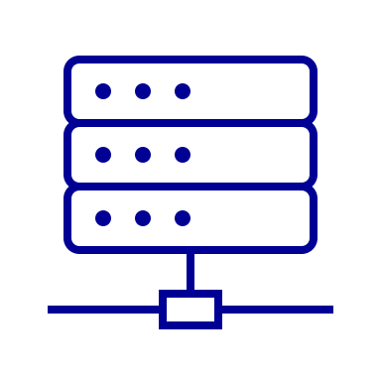


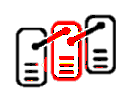


bootstrapping Gaia-X ecosystems
Users
Consumer
Provider
Applications
Service Offerings
Portal
VC Wallet
Federator
SSI/VC issuer
SSI/VC verifier
MVG ecosystem
Infrastructure
Catalogue Cache
Compute Cluster
Federator
DLT
Validator nodes
Data Contracts
Exchange Logging
Federator
ID registry
licensed under CC-BY-4.0, deltaDAO AG

Slide 17














bootstrapping Gaia-X ecosystems
MVP Gaia-X Federation Services & Decentralized Core Grid
u
users
data owners
AI/ML providers & data scientists
consumers
analysts & auditors
governance
ai
federators
p
portals & decentral applications (dApps)
portals / GUI
applications / API
Blockexplorers
t
trust & identity
DIDs/ wallets
SSI/VC issuers
SSI/VC verifiers
Compliance technically enforced across all levels
d
data contracting service
(private) data assets
(private) algorithms
CtD clusters
access controllers
c
federated catalogue
metadata caches
e
exchange logging & DLT core grid
DID registry
data access & exchange contracts
federated catalogue, access records & audit trails
validator nodes
licensed under CC-BY-4.0, deltaDAO AG
🀰 federation services related 🀰 other infrastructure, apps, users

Slide 18
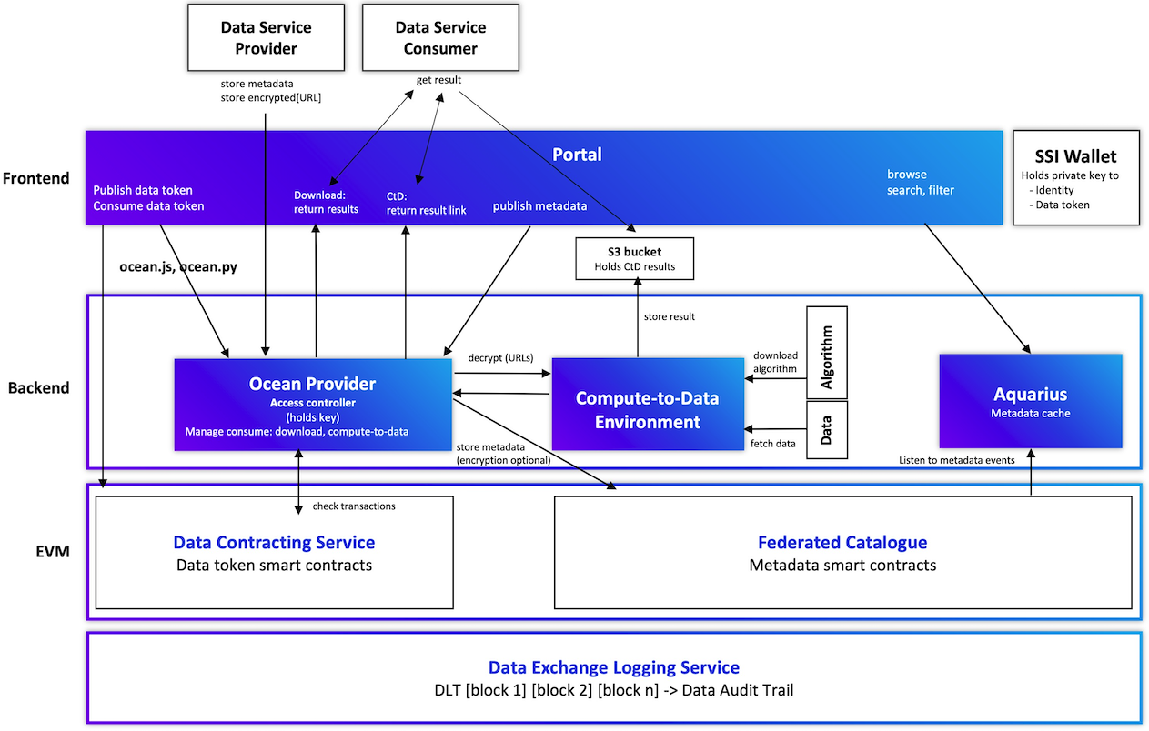

bootstrapping Gaia-X ecosystems
deep dive #1
Decentralization & Distribution
across all layers
licensed under CC-BY-4.0, deltaDAO AG

Slide 19
bootstrapping Gaia-X ecosystems
service provider + federator
creation and connection of complex services
consumers
consumers
from atomic and elementary services
portal for
portal
catalogue cache
space B
consumer
service offering
federator
service provider
validator
compute cluster
federation services toolbox
data providers
portal for
space A+B
federator+CSP
B
prosumers
portal for
A
space B+C
portal for
C
space A+B+C
licensed under CC-BY-4.0, deltaDAO AG

Slide 20






bootstrapping Gaia-X ecosystems
remove all single points of failure from the federation
ground truth &
consensus state
federation services toolbox
service catalogue
federator
service provider
consumer
catalogue cache
service offering
compute cluster
DLT
verifiable credential wallet
validator
licensed under CC-BY-4.0, deltaDAO AG

Slide 21
bootstrapping Gaia-X ecosystems
federation of interoperable autonomous Gaia-X ecosystems
Ocean ecosystem
ecosystem 2
ecosystem 3
ecosystem …
ecosystem n
technical interop.
usage plane
extended governance
management plane
common digital Gaia-X governance
Gaia-X Trust Framework
Gaia-X Registry service
Gaia-X Compliance service
trust plane
federation services toolbox
service catalogue
service provider
consumer
catalogue cache
data
compute cluster
algorithm
DLT
verifiable credential wallet
federator
validator
Image is licensed under a CC BY 4.0 license, Gaia-X European Association for Data and Cloud AISBL.
Remixed by deltaDAO AG for illustration purposes.

Slide 22
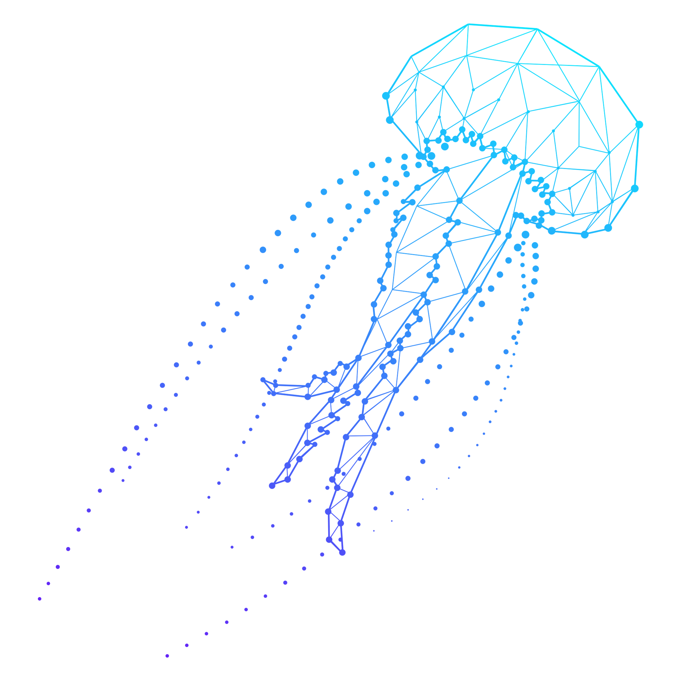
Minimal Viable
Gaia-X portal
powered by Ocean Protocol

Slide 23
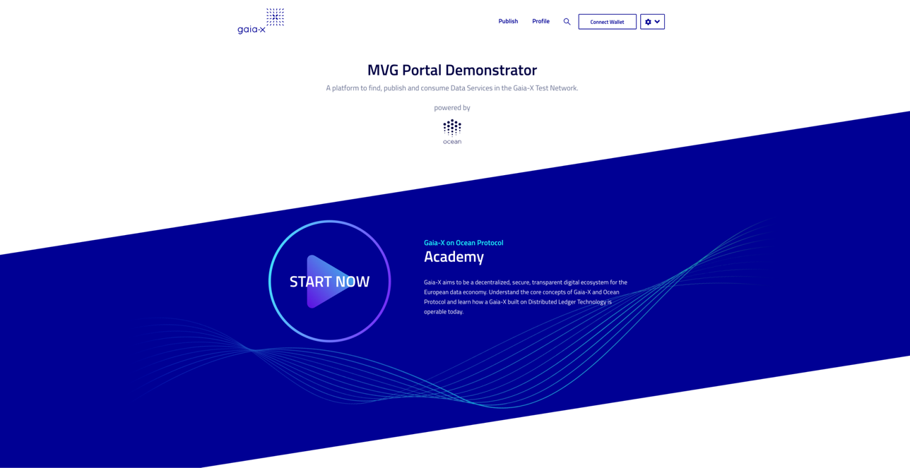

bootstrapping Gaia-X ecosystems
Hackathon #1 - First Minimal Viable Gaia-X Demonstrator
https://portal.minimal-gaia-x.eu
video: https://youtu.be/R49CXPTRamg
Minimal Viable Gaia-X blogpost
licensed under CC-BY-4.0, deltaDAO AG

Slide 24
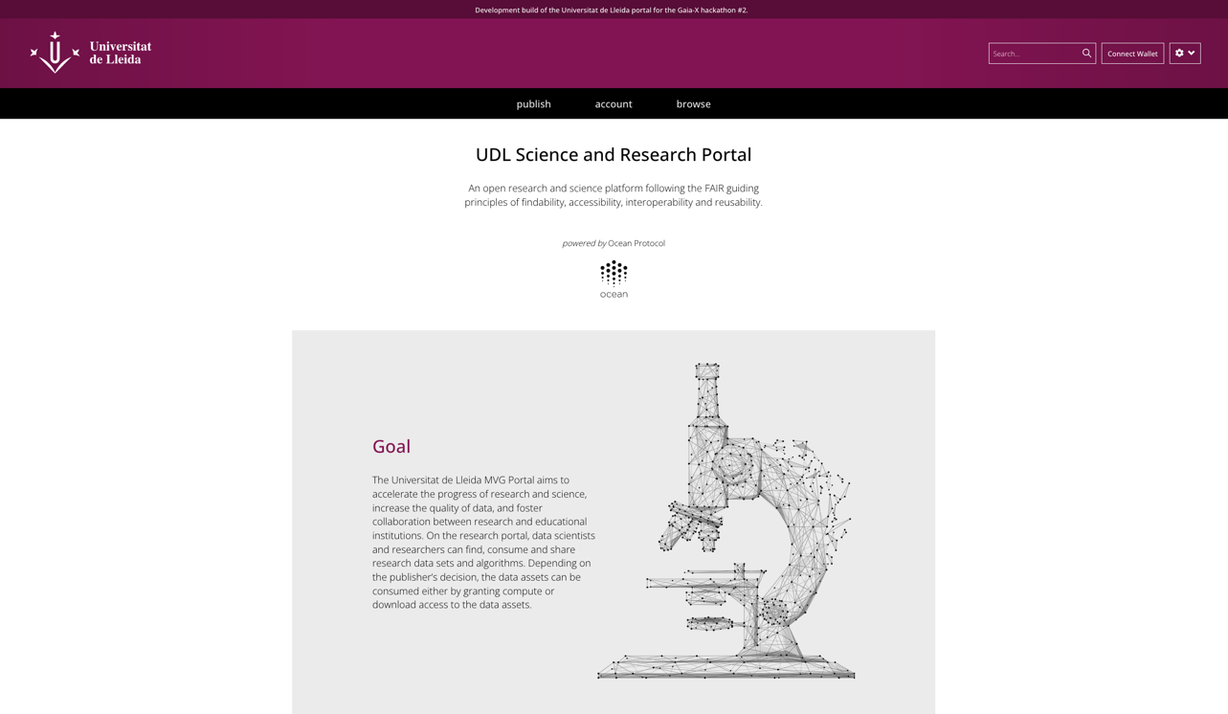
bootstrapping Gaia-X ecosystems
for F.A.I.R. science and to connect researchers & businesses
https://udl.portal.minimal-gaia-x.eu
UDL blogpost
licensed under CC-BY-4.0, deltaDAO AG

Slide 25
bootstrapping Gaia-X ecosystems
for SMEs and GDPR-compliant data usage
https://forever.portal.minimal-gaia-x.eu
foreverontheblockchain Blogpost
licensed under CC-BY-4.0, deltaDAO AG

Slide 26
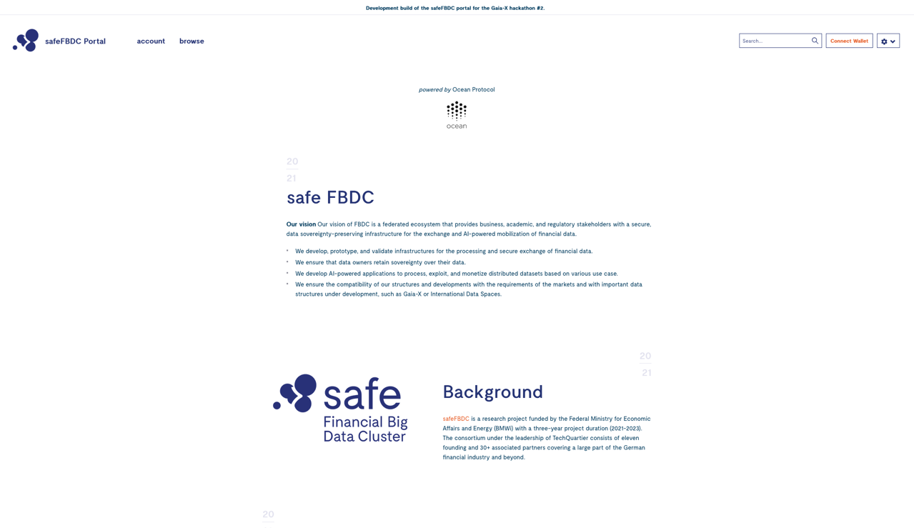
bootstrapping Gaia-X ecosystems
for regulators and the finance industry
https://safefbdc.portal.minimal-gaia-x.eu
safeFBDC Blogpost
licensed under CC-BY-4.0, deltaDAO AG

Slide 27



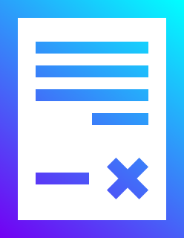




bootstrapping Gaia-X ecosystems
compute-to-data enables true technical data sovereignty
data
data service
algorithm
scientists
consumers
results / trained models
data portals based on
smart contracts
portal providers
access control based on
smart contracts
technical
data sovereignty
data owners
private
data asset stays
data asset
on-premise
licensed under CC-BY-4.0, deltaDAO AG
Notes:
What is the potential function of smart contracts in the context of tracking and tracing subsequent data use by the organisations with whom data were shared?
Can smart contracts be used as a tool to support data pooling between various data owners and as a tool to conditionalise the data sharing?

Slide 28
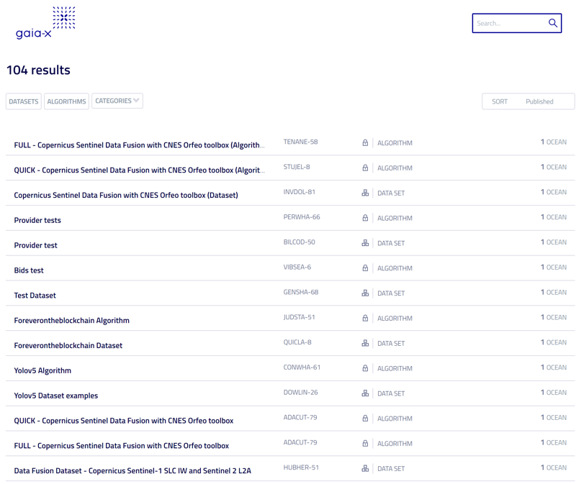
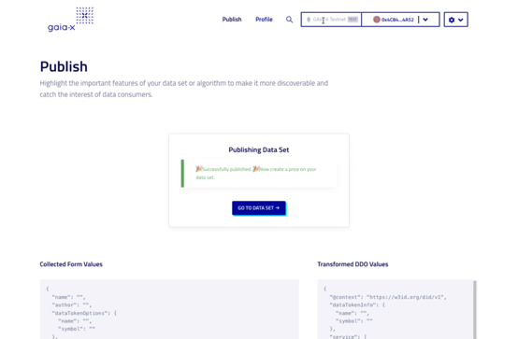
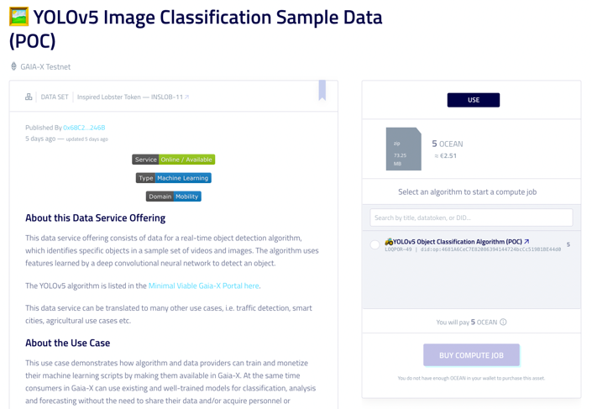
bootstrapping Gaia-X ecosystems
decentralized catalogue, minutes to publish and consume
https://catalogue.minimal-gaia-x.eu
tutorial: https://youtu.be/eAbnM5bfEMc
licensed under CC-BY-4.0, deltaDAO AG

Slide 29
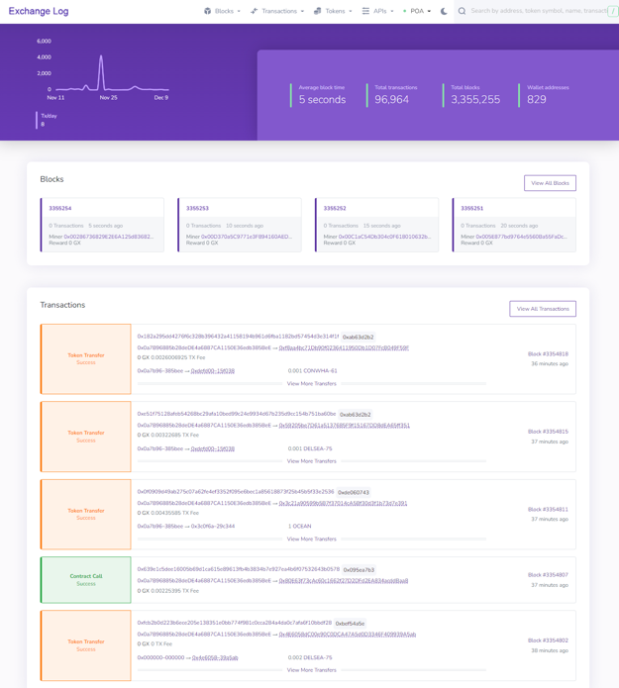
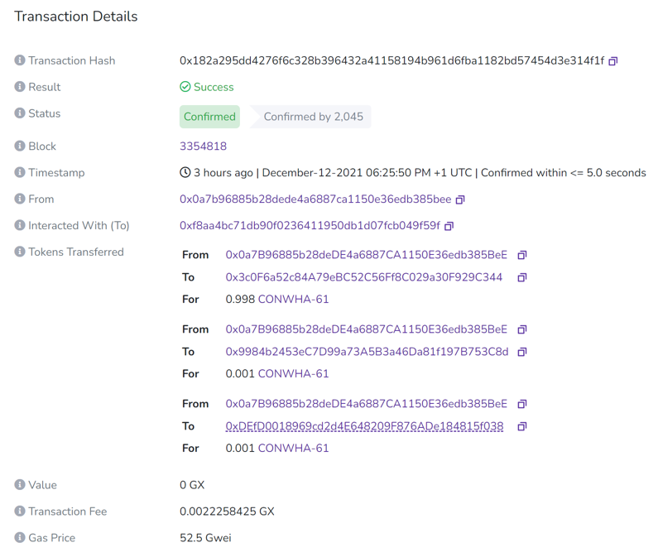
bootstrapping Gaia-X ecosystems
automatic audit trails & security & privacy by design
https://exchangelog.minimal-gaia-x.eu/
licensed under CC-BY-4.0, deltaDAO AG

Slide 30
data economy solutions – GDPR compliant
deltaDAO AG Geibelstraße 46b 22303 Hamburg Germany
Website https://delta-dao.com
Mail contact@delta-dao.com
Twitter @deltadao
LinkedIn deltadao
YouTube deltaDAO
Presented by
Kai Meinke Member of the Board deltaDAO AG kai@delta-dao.com +49 151 1257 9443
Sea Creatures and Ocean logo licensed under CC-BY-SA-4.0, Ocean Protocol Foundation Ltd.

